Slide 1
JSB Stuff to sell
I quit my job, am selling all of my possessions, & am backpacking through SE Asia for a year. Hope you see something you like – your purchase will help me stay out there for a year!
#helpfundmytrip

Slide 2
Kitchen utensil drawer holder - $2

Slide 3
Lamp - $10

Slide 4
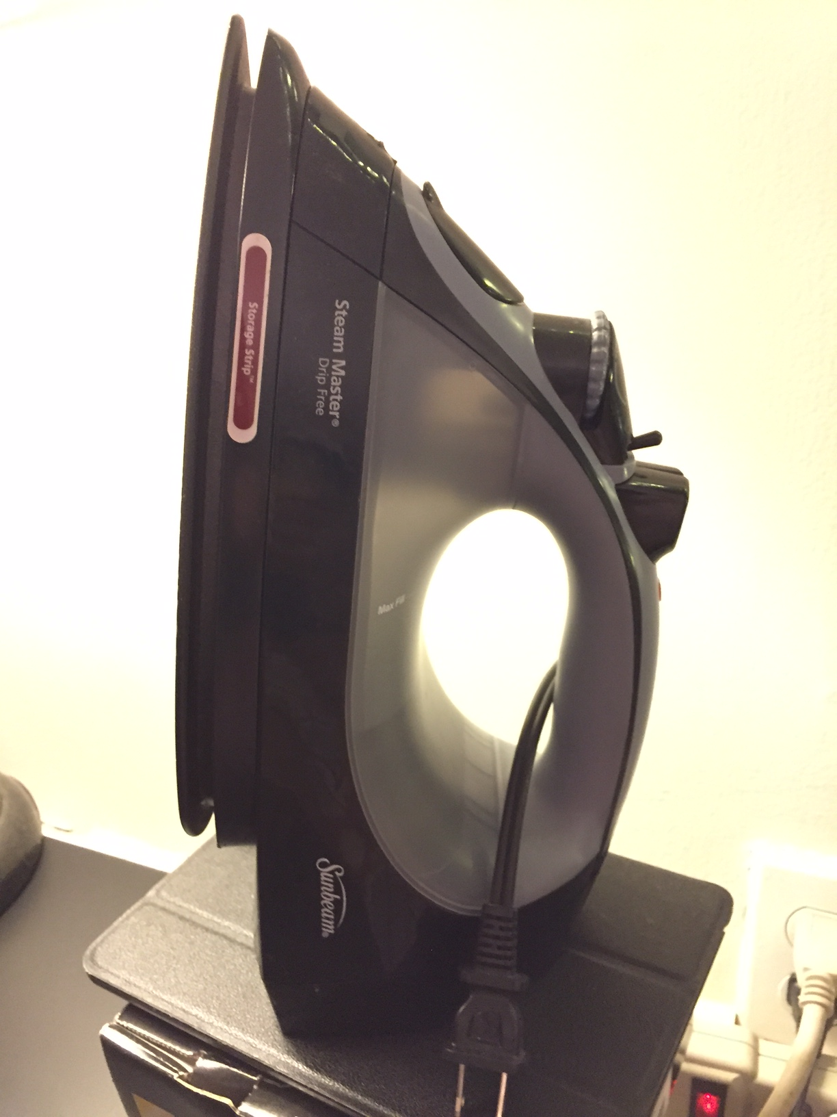
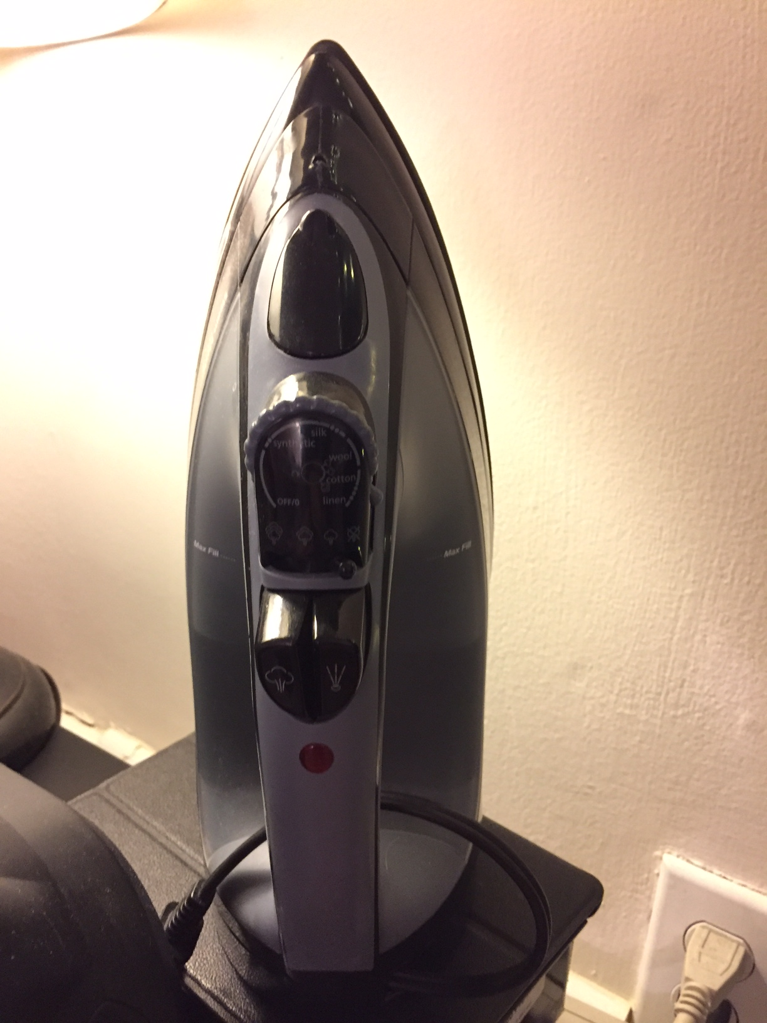
Ironing board, iron & door hanger - $25
Iron = $9
Iron Board = $7
Iron Board Hanger = $15

Slide 5
Tree city - $12
8 x 10 inches
Artist = Doug Rhodes
Print

Slide 6
Art clock - $60
Working clock
Beautiful piece of art
13 x 5.5 inches

Slide 7
Plant pots - $5 each

Slide 8
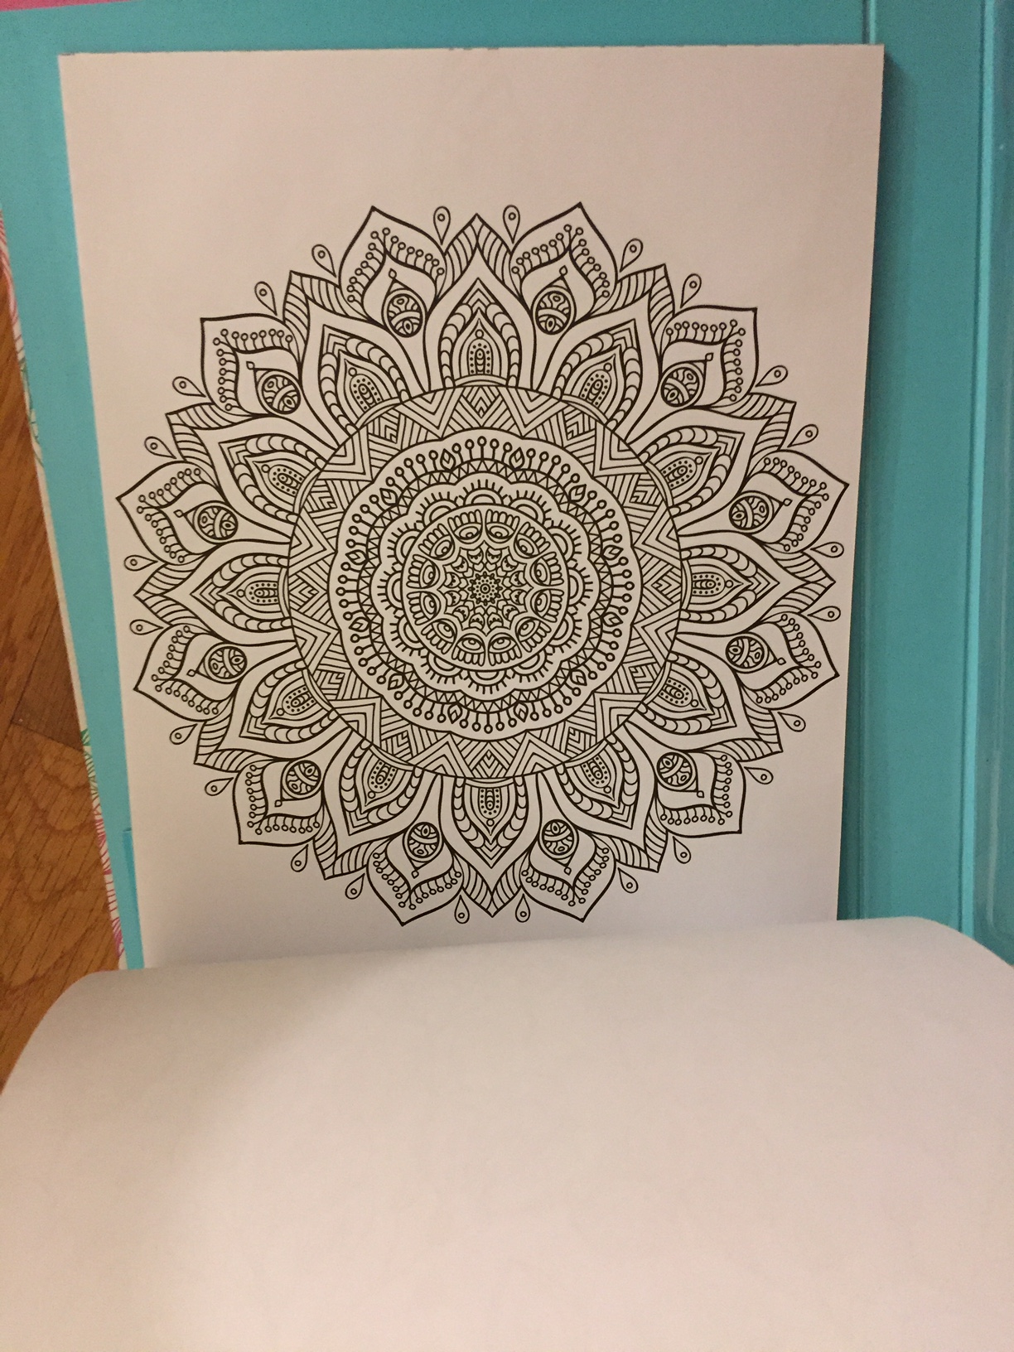
Coloring book - $6

Slide 9
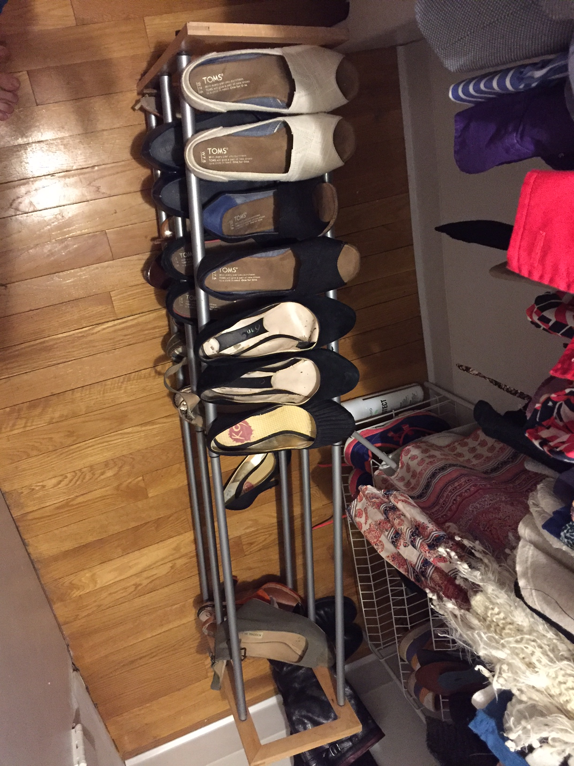
Expandable (up to 3’ 10”) shoe rack - $12

Slide 10
Shoe rack - $7
2’ 2”
4 shelves

Slide 11
Cuisinart Blender/processor set - $65
Almost as good as new – most of the parts have never been used
VELOCITY Ultra Trio 1 HP Blender/Food Processor with Travel Cups
BFP-650

Slide 12
7 xmas in paris plates - $28 ($4/plate)

Slide 13
Salad spinner - $14

Slide 14
Strainers - $5 each

Slide 15
Pots - $5 each

Slide 16
Blender - $11

Slide 17
Two 10 pound weights - $15
Good condition!
Get buff ;)

Slide 18
Bike hanger - $20
Brand new – unopened box!

Slide 19
Chill camping chair - $15

Slide 20
Soda stream - $25

Slide 21
lamp- $5

Slide 22
Apples to apples - $5

Slide 23
Wikipedia the game about everything - $9
Still in store packaging
Brand new

Slide 24
The game of life - $7
Good condition – all pieces accounted for ☺

Slide 25
Scrabble - $7
Good condition – all pieces accounted for ☺

Slide 26
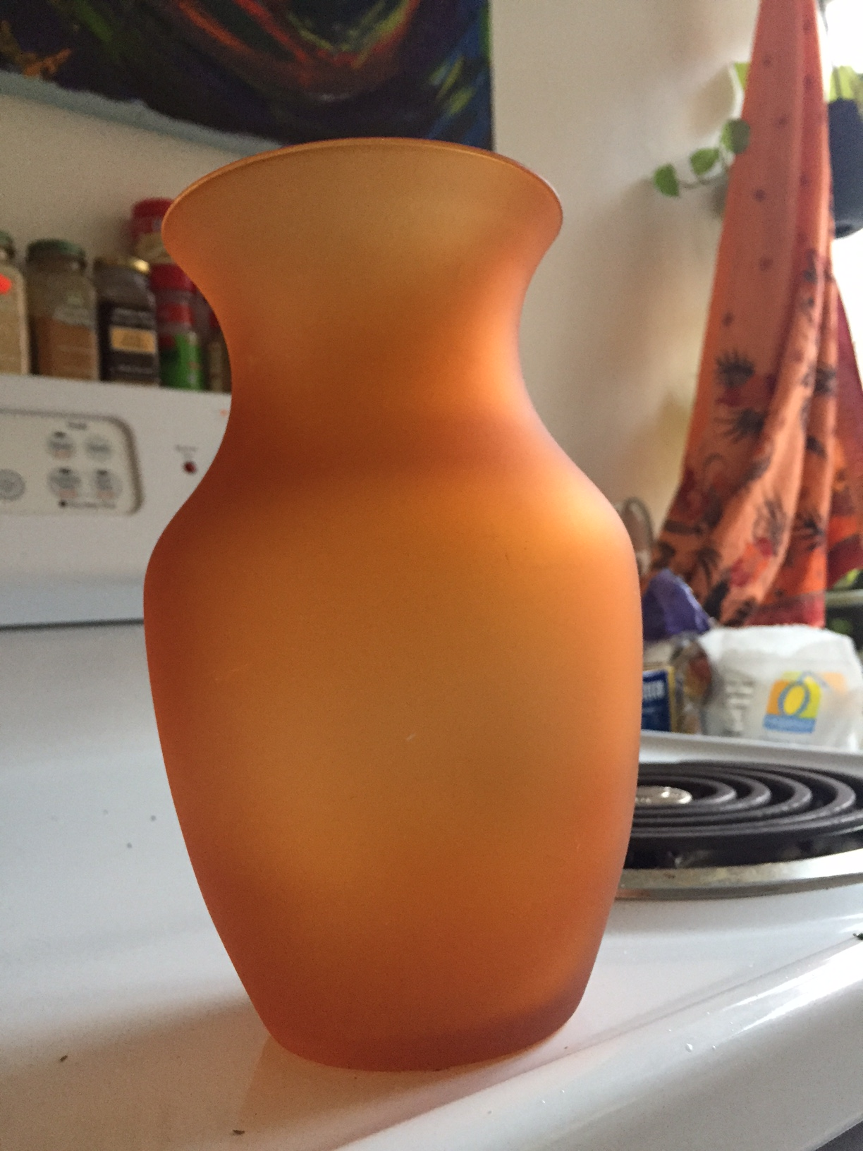
Vases – $5 each!

Slide 27
Portable dvd player - $10

Slide 28
Snazzy hat - $5

Slide 29
Dvd’s - $1 each
The Little Rascals
JUNO
The Dark Knight Rises

Slide 30
Paper basket - $2
Keep those papers organized or store your magazine in…

Slide 31
Flower print canvas - $20
2 feet 6 inches long by 2 feet wide

Slide 32
Drum pad - $7

Slide 33
Lightly used toms wedges (7.5) - $30
They are too small for me ☹

Slide 34
Lightly used toms wedges (7.5)- $30
They are too small for me ☹

Slide 35
Dooney & bourke - $90

Slide 36
Brand new coach wallet- $100

Slide 37
Funky purse - $20

Slide 38
Black folding table - $10

Slide 39
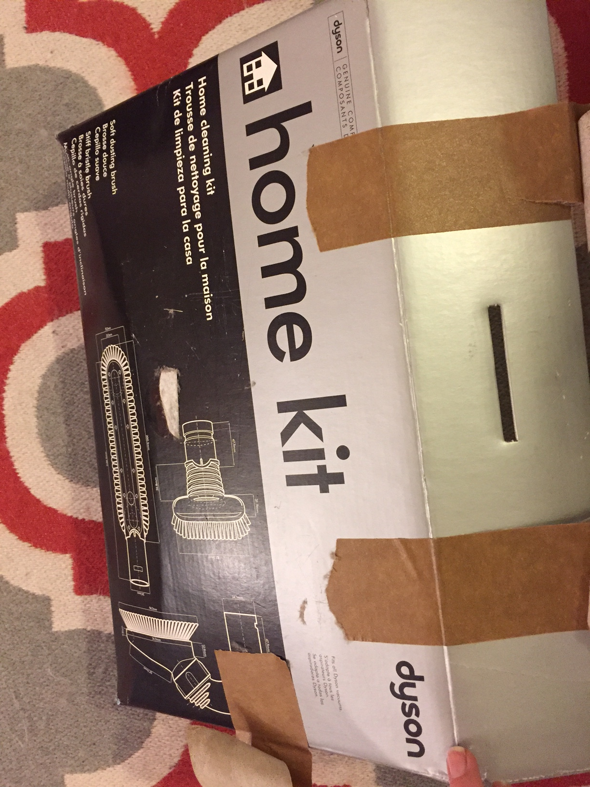
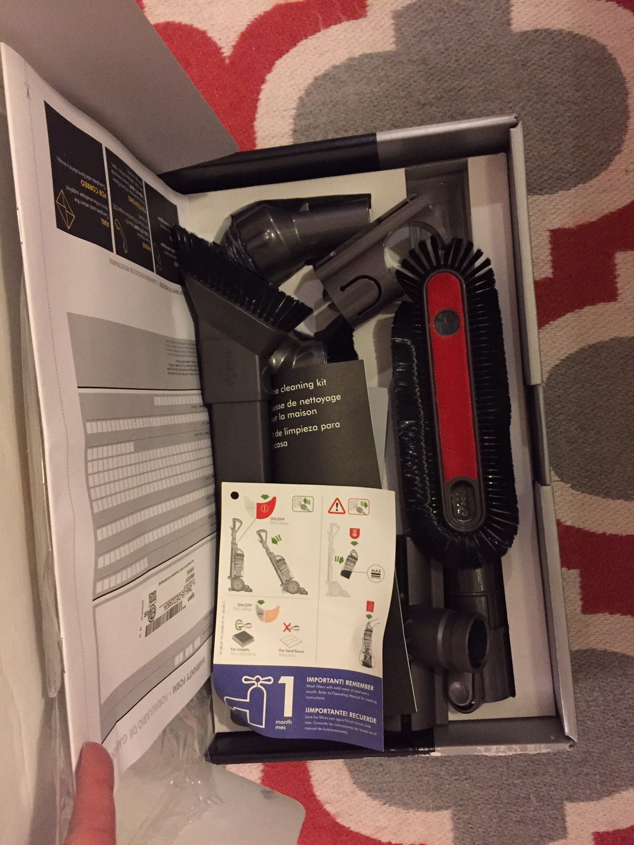
Dyson ball multi floor vacuum dv40 - $97
Come with vacuum accessories!
Originally a $300 vacuum cleaner… I know most of you are thinking “WHY!” … its pretty awesome though! ☺

Slide 40
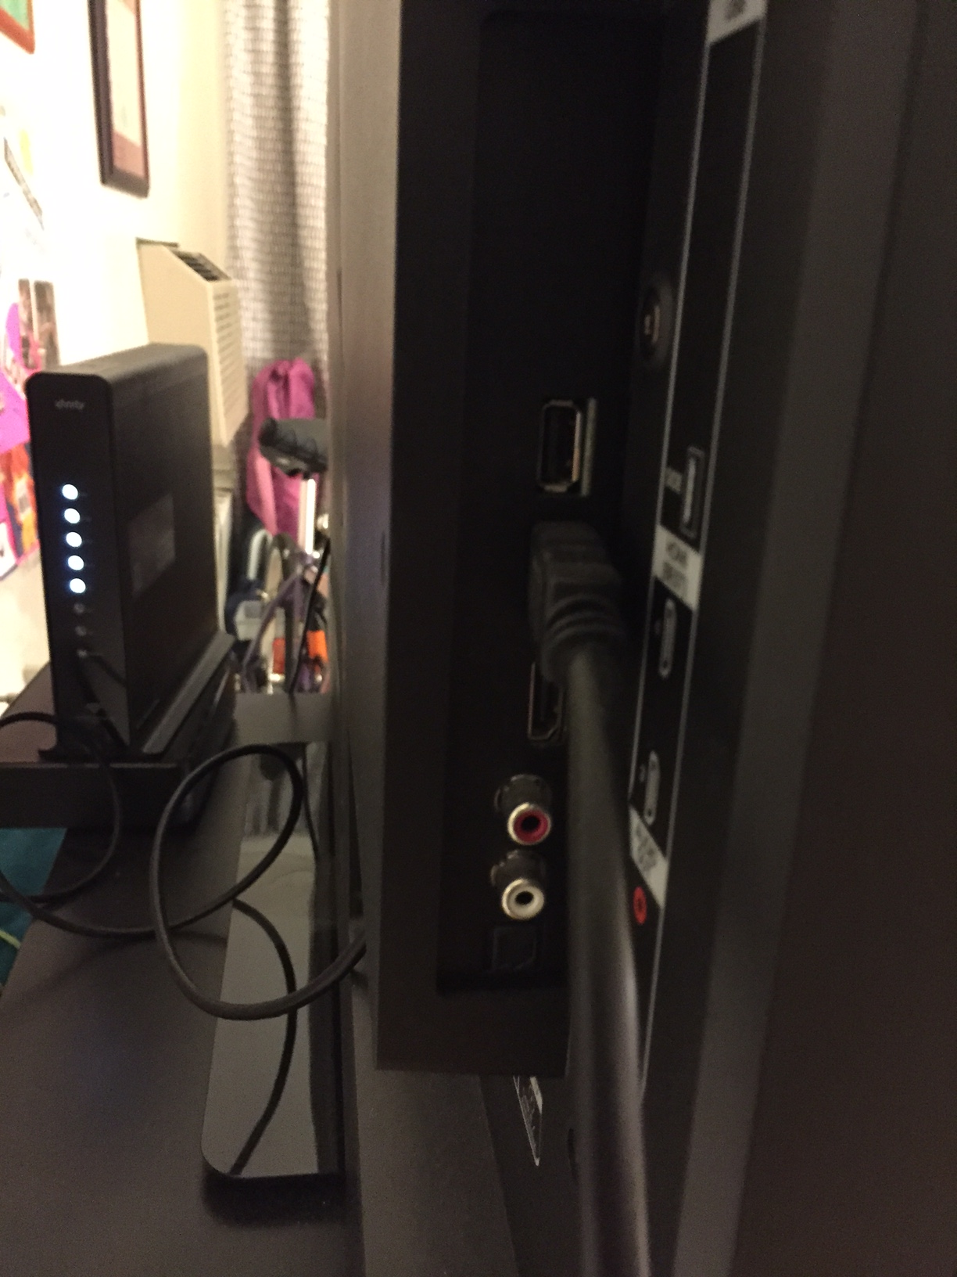
49 inch Vizio smart tv - $175
HDMI cord & laptop adapter
Comes with the following apps:
Hulu plus
Netflix
YouTube
Yahoo! TV store
Amazon
Pandora

Slide 41
Black trash can - $5

Slide 42
Alarm Clock - $6
Remember these?
Disconnect from your phone and reconnect with your childhood self

Slide 43
Side or coffee table - $12

Slide 44
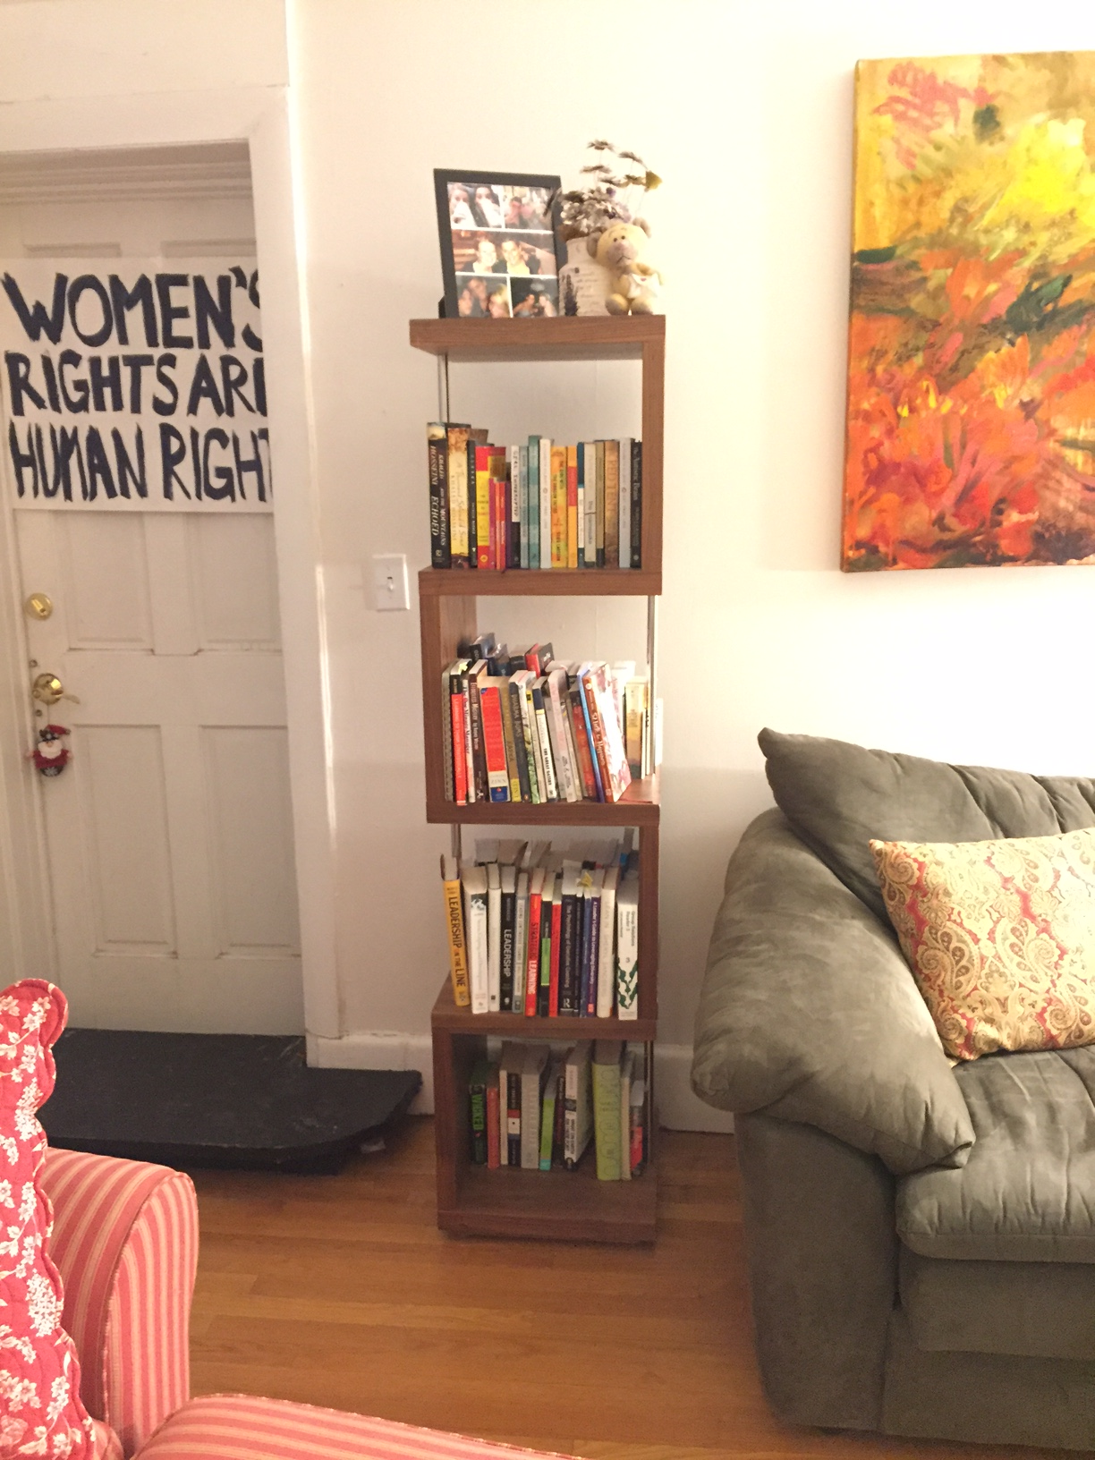
Super trendy bookshelf (66” tall by 16” wide) - $72

Slide 45
Tan folding side table - $10

Slide 46
Painting - $60
Light vs. darkness
Birth vs. death
Painted live during a concert

Slide 47
Green rug - $45
8’ 1” x 4’ 11”

Slide 48
Grey, cream & burnt orange rug - $45
7’ 3” x 5’ 5.5”

Slide 49
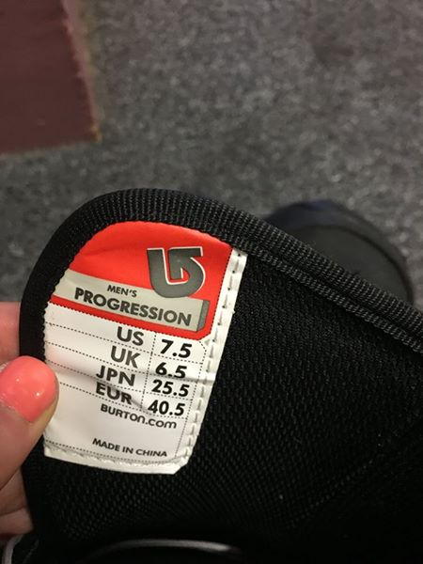
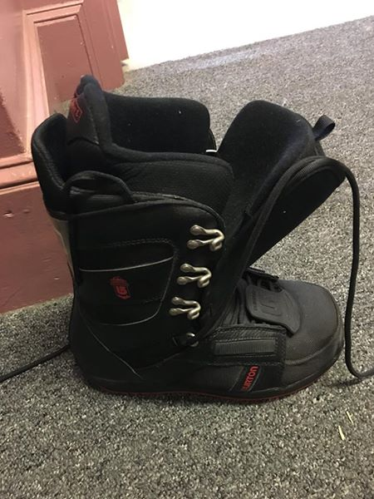
Burton Snowboard with Boots and Bag - $163 – shoe size 7.5

